Slide 1

Cassandra
Workshop 1

Slide 2
Plan of Action
Activities:-
5 Workshops
Assignment releasing after every workshop (most probably next day)
2 Real time quizzes in between Workshops
Workshop will be on theoretical cum discussion and innovation basis of previous assignment.
2nd workshop can be an exception.
A Dummy competition instead of last assignment.
Weightage(Total = 100%):-
First 3 Assignments (5% each)(5x3=15%)
Last Assignment (10%)(10x1=10%)
2 Real Time Quiz (5% each)(5x2=10%)
Dummy Competition(15%)
Main Event(50%)

Slide 3

DATA SCIENCE
According to Wikipedia:-
Data science is an interdisciplinary field that uses scientific methods, processes, algorithms and systems to extract knowledge and insights from noisy, structured and unstructured data,^{[1][2]} and apply knowledge and actionable insights from data across a broad range of application domains. Data science is related to data mining, machine learning and big data.
Diagrammatically:-

Slide 4
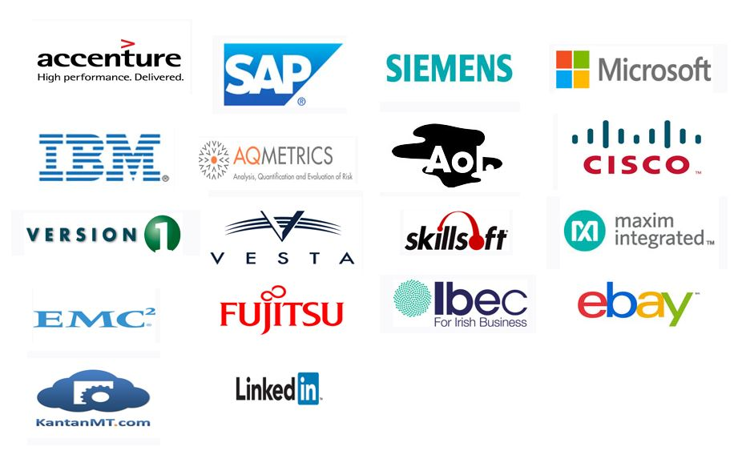
Why Data Science?
Tons and Tons of Data Generation
Need to analyse data behaviour => Business Growth
Tech Giants investing in it, Ex -

Slide 5
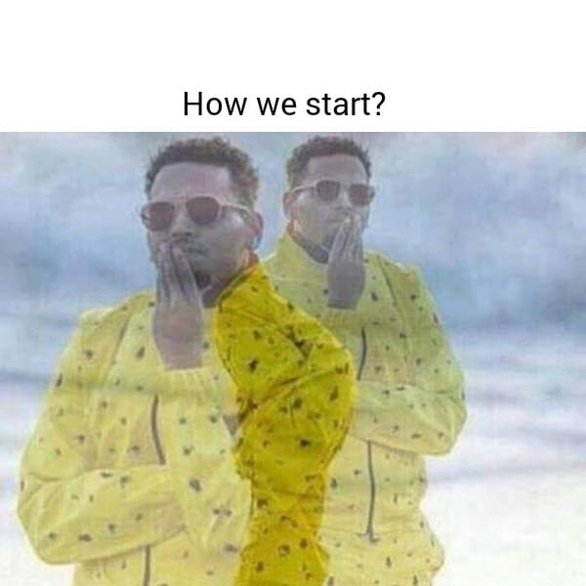

LET’S START WITH TERMINOLOGIES

Slide 6
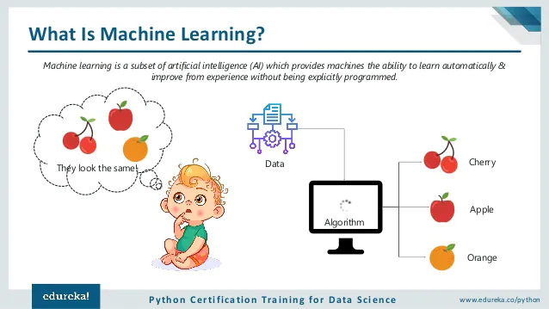

Slide 7
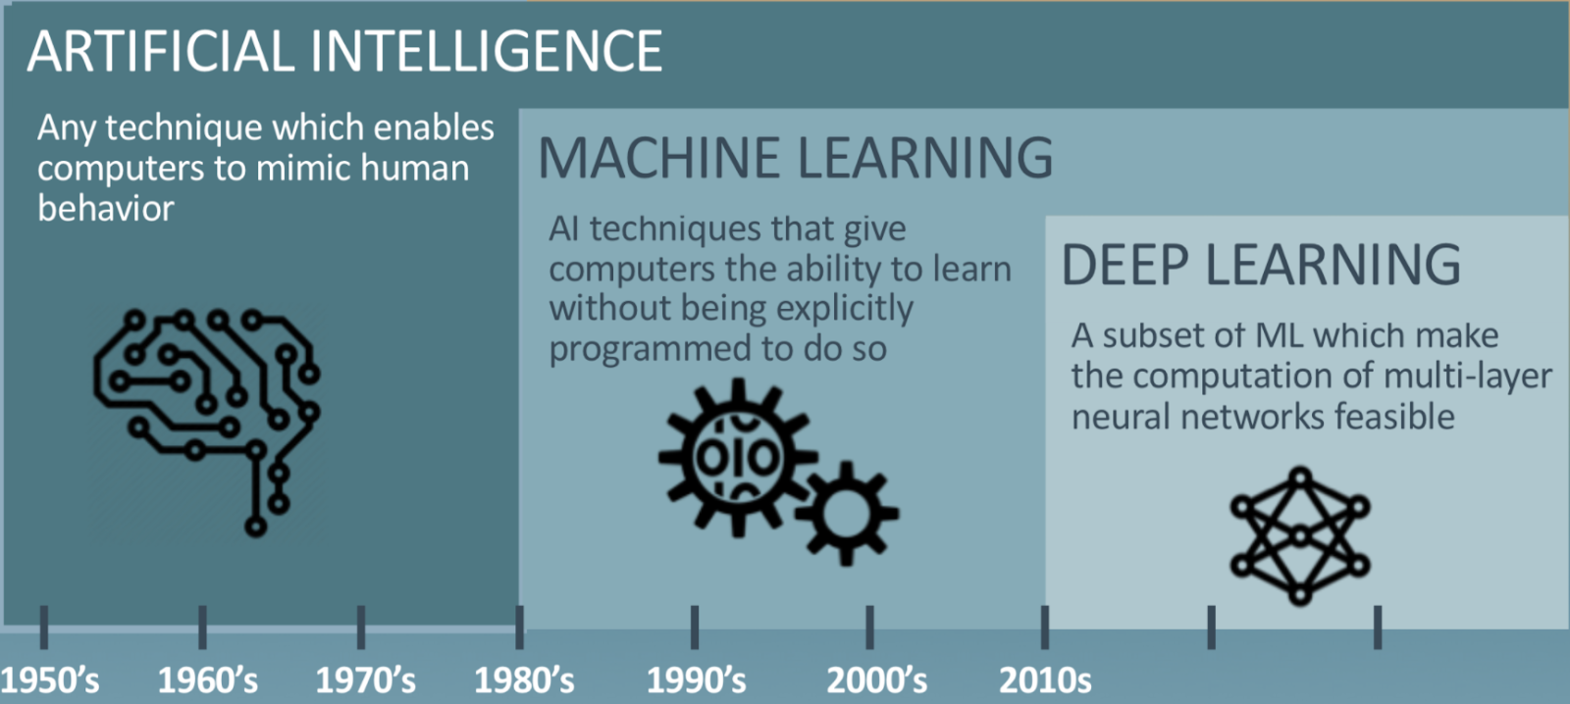
AI/ML/DL

Slide 8
Mind-Blowing Applications Of AI
Tonight Showbotics: Jimmy Meets Sophia the Human-Like Robot
4 Mind-Blowing Ways Facebook Uses Artificial Intelligence
The Machine Learning Behind Alexa’s AI Systems
Introduction to Deep Learning and Self-Driving Cars

Slide 9
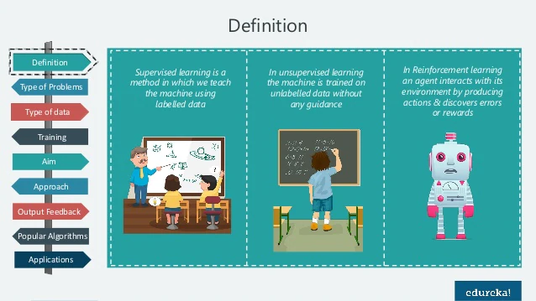
SUPERVISED/UNSUPERVISED/REINFORCEMENT
Source: - Edureka

Slide 10
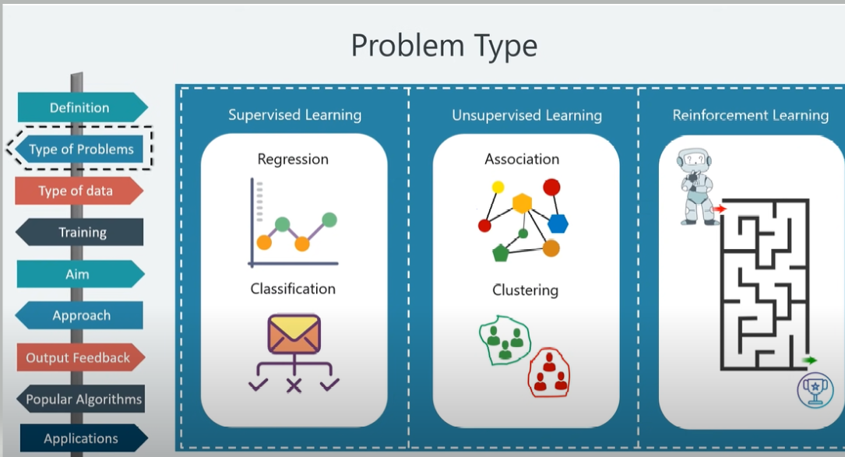
Source: - Edureka

Slide 11
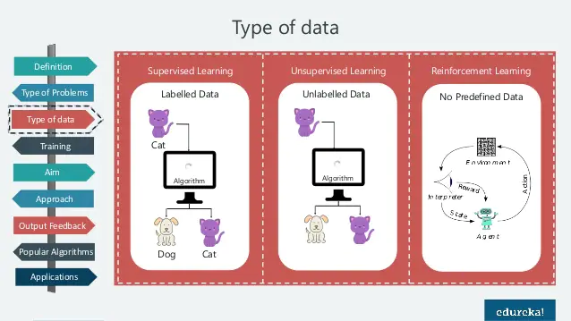
Source: - Edureka

Slide 12
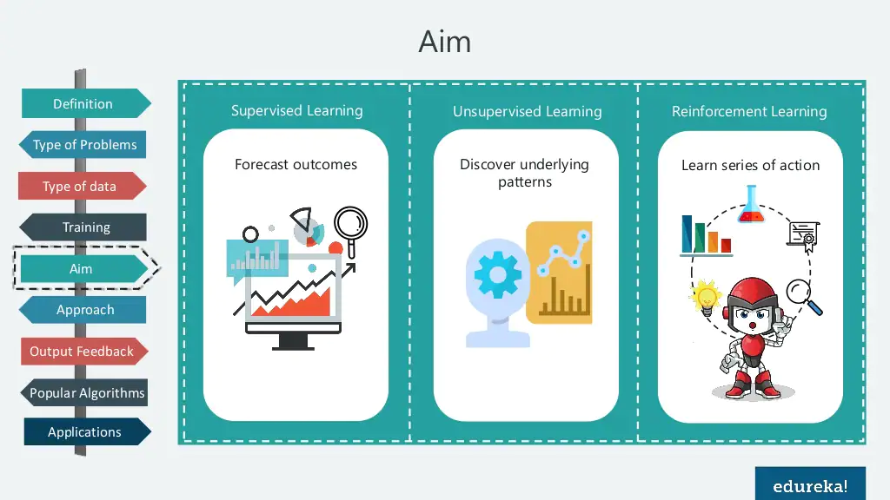
Source: - Edureka

Slide 13
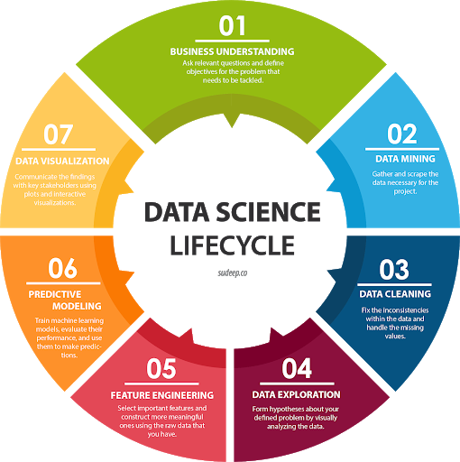
DATA SCIENCE
LIFECYCLE

Slide 14
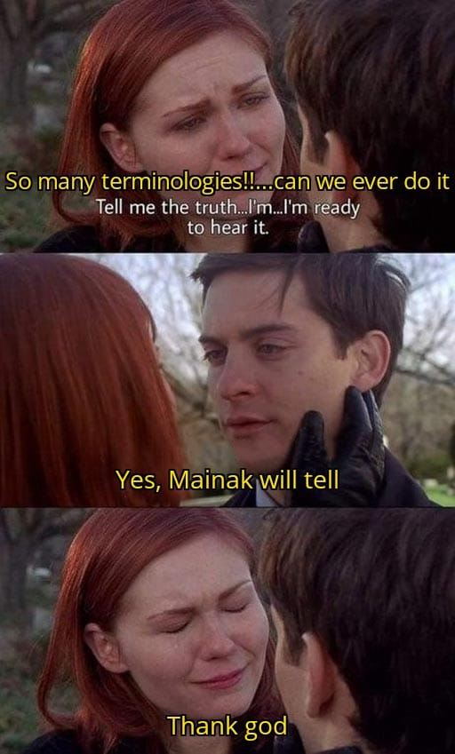

Slide 15
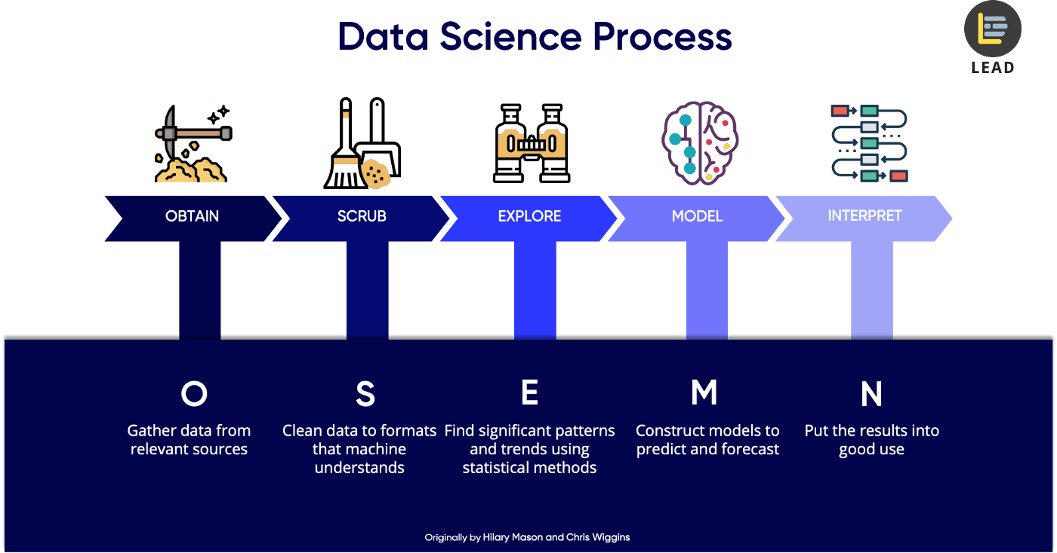

Slide 16



Platform setup
First of all we have to set up our python environment.
For our data science project we can use different platforms like…….
Kaggle
Google Colab
Anaconda with Jupyter Notebook in your PC

Slide 17


Obtain
For Data science projects the first requirement is to have some proper data.
In this step we need to collect our own data or fetch some open source datasets from some web sites.
For example: Kaggle, UCI Machine Learning Repository, Data.gov etc.

Slide 18

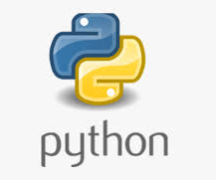

Scrub
In this part we have to convert the data from one format to another and consolidate everything into one standardized format across all data.
Also in this step we need to check for missing or garbage values and replace them accordingly.
Libraries used: Python, Pandas, Numpy etc.

Slide 19


Explore
In this step we have to go through all the features of the data and inspect its properties to extract features and test significant variables and visualize them to identify significant patterns in our data.
Libraries used: Numpy, Pandas, Matplotlib, Seaborn etc.

Slide 20

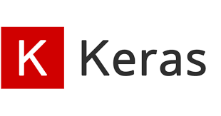


Model
In this step we pass the preprocessed dataset in to our machine learning algorithm to predict future states or classify them into different categories or group values using clustering.
We can also optimize our algorithms to get better results.
Libraries used: Sci-kit Learn, Keras, XGBoost, Optuna etc.

Slide 21
Interpret
Interpreting data refers to the presentation of your data to a non-technical layman.
We need to visualize the results and findings obtained throughout the process.
Libraries used: Matplotlib, Seaborn etc.

Slide 22
Hands On Time

Slide 23
USEFUL YOUTUBE PLAYLIST AND VIDEOS
Krish Naik Machine Learning Playlist (Very Useful)
StatQuest Machine Learning Playlist (Very Useful)
Downloading Python and Pycharm Installation
How to Read Dataset in Google Colab from Google Drive
What is Kaggle?
Install Anaconda with Jupyter Notebook
Opening Jupyter Notebook on Windows

Slide 24
USEFUL LINKS ,REFERENCES AND SITES
Colaboratory
Jupyter
Kaggle
Medium:Data Science
Analytics Vidhya
Coursera

